Slide 1
Constitution Day 2022
Spokane Falls Community College
Spokane, Wa
Notes:
“Hey there, Sasquatch
You most likely know that the Fourth of July is the day that we celebrate the Declaration of our Independence, but did you know that on September 17th we celebrate the signing of the Constitution?

Slide 2
What is Constitution Day?
This day commemorates the signing of the United States Constitution on September 17, 1787.
Each educational institution that receives Federal funds for a fiscal year is required to hold an educational program about the U.S. Constitution for its students.
Notes:
In 2004, Senator Robert Byrd passed an amendment renaming the holiday “Constitution Day and Citizenship Day,” which requires public schools and institutions to provide information on the history of the country’s Constitution.

Slide 3
Notes:
The first words of the Constitution, the preamble, are some of the most famous words associated with the United States of America “We the People of the United States, in Order to form a more perfect Union, establish Justice, insure domestic Tranquility, provide for the common defence, promote the general Welfare, and secure the Blessings of Liberty to ourselves and our Posterity, do ordain and establish this Constitution for the United States of America.”
The Constitutional Convention met from May 25 through September 17th, 1787.
Benjamin Franklin, at 81, was the oldest representative and Jonathan Dayton, at 26, was the youngest. The average representative of the Constitutional Convention was 44. The members of the Convention consisted of lawyers, soldiers, planters, educators, ministers, physicians, financiers, and merchants.

Slide 4
Notes:
What is a constitution anyway? A constitution embodies the fundamental principles of a government and outlines the purpose of the different branches of government. The branches of government were designed to balance power and to combat tyranny.
Our Constitution has seven articles.
Article I: Creates Congress and gives it legislative powers.
Article II: Creates the presidency and gives it executive power.
Article III: Creates the U.S Supreme Court and authorizes Congress to create lower federal courts.
Article IV: Differentiates that State and Federal powers have different powers.
Article V: States that a two-thirds majority is required to amend the constitution.
Article VI: Concerns debts against the new country
Article VII: States that nine states are sufficient to ratify the Constitution.
The Teaching Company – Law School for Everyone: Constitutional Law “Origins and Functions of the Constitution”

Slide 5
https://www.begislaw.com
https://campustechnology.com/articles/2021/01/20/student-identity-matters-online-too.aspx?admgarea=News
Notes:
The phrase “Constitutional Rights” is one that you have most likely heard. Despite this, the constitution does not give us our rights, it only guarantees them.
What does this mean? The people had all their rights and liberties before they made the Constitution. The Constitution was formed, among other purposes, to make the people's liberties secure-- secure not only as against foreign attack but against oppression by their own government. They set specific limits upon their national government and upon the States, and reserved to themselves all powers that they did not grant. The Ninth Amendment declares: "The enumeration in the Constitution, of certain rights, shall not be construed to deny or disparage others retained by the people.“

Slide 6
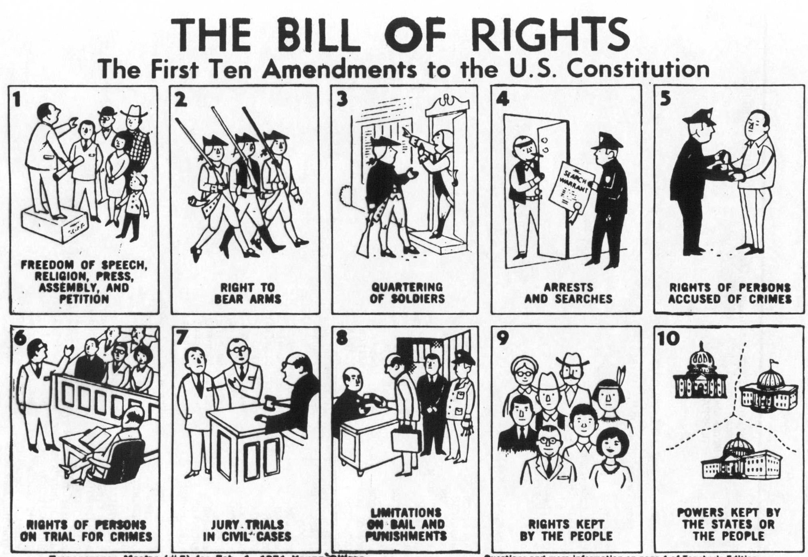
Image: Bill of Rights depicted in cartoon format from 1971 Young Citizen teacher’s guide transparency. Courtesy: Syracuse University
Notes:
The Bill of Rights has its own day, December 15th. The first twelve amendments to our constitution were introduced to the First Congress in 1789. There are currently 27 amendments, the most recent of which was ratified in 1992.
There is no mention of Education in the Constitution itself.
The 10th Amendment states that powers not delegated to the federal government are reserved to the states or to the people. Thus, education became a function of the state rather than the federal government.
While education may not be a "fundamental right" under the Constitution, the equal protection clause of the 14th Amendment requires that when a state establishes a public school system, no child living in that state may be denied equal access to schooling.
The 14th amendment is a modification to Article I, section 2: it was passed by Congress June 13, 1866 and ratified July 9, 1868.

Slide 7
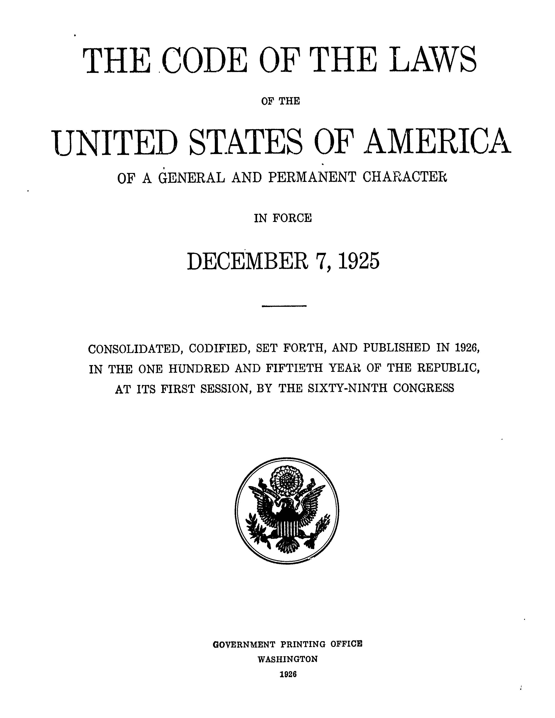
THE CODE OF LAWS OF THE UNITED STATES OF AMERICA
Title 20 – Education
Chapter 28 – Higher Education Resources and Student Assistance
Chapter 31 – General Provisions Concerning Education
Chapter 48 – Department of Education
Notes:
Published in 1926 by the Office of the Law Revision Counsel of the U.S. House of Representatives, the U.S. Code of Laws covers 53 titles. Title 20 details laws regarding education, there are currently 80 Chapters. A link to the full code will be included at the end of this presentation.
The chapters in this section of the Code of Law cover everything from the creation of the Department of Education to Vocational and Environmental Education.
The department of education was created in 1980 by combining offices from several federal agencies. ED's 4,400 employees and $68 billion budget are dedicated to:
Establishing policies on federal financial aid for education and distributing as well as monitoring those funds.
Collecting data on America's schools and disseminating research.
Focusing national attention on key educational issues.
Prohibiting discrimination and ensuring equal access to education

Slide 8
Notes:
Around campus, you will have likely heard of “title nine”.
In June 1972, President Nixon signed Title IX of the Education Amendments of 1972 into law. Title IX is a comprehensive federal law that has removed many barriers that once prevented people, on the basis of sex, from participating in educational opportunities and careers of their choice. It states that: No person in the United States shall, on the basis of sex, be excluded from participation, in be denied the benefits of, or be subjected to discrimination under any education program or activity receiving Federal financial assistance
Congress enacted Title IX with two principal objectives in mind: to avoid the use of federal resources to support discriminatory practices in education programs, and to provide individual citizens effective protection against those practices

Slide 9
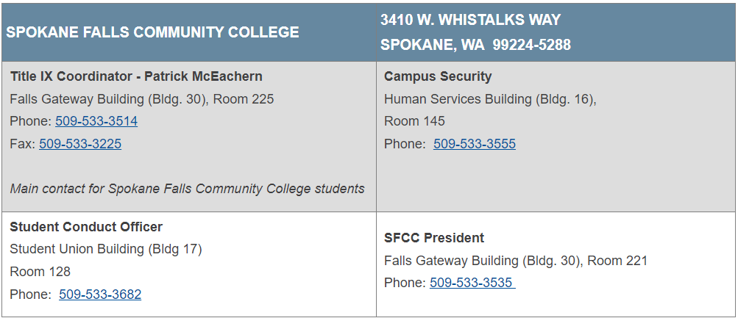
Resources for SFCC
Notes:
The Faculty and Staff at SFCC strives daily to promote safety and inclusion on our campus. Please utilize the link at the top of this slide for more information and resources about title nine at SFCC.

Slide 10
References & Links to Explore
The Teaching Company – Law School for Everyone: Constitutional Law “Origins and Functions of the Constitution”
National Archives
https://www.archives.gov/founding-docs/constitution
https://www.archives.gov/founding-docs/constitution-transcript
https://www.archives.gov/founding-docs/bill-of-rights-transcript
https://www.archives.gov/founding-docs/constitution-q-and-a
Library of Congress
https://www.loc.gov/item/rbpe.24203100/
The White House
https://www.whitehouse.gov/about-the-white-house/our-government/the-constitution/
US Code of Laws
https://www.govinfo.gov/app/details/USCODE-2017-title20/context
Department of Education
https://www2.ed.gov/about/landing.jhtml
https://sites.ed.gov/titleix/policy/
FERPA - Family Educational Rights and Privacy Act
https://studentprivacy.ed.gov/?src=fpco
Government Book Talk
https://govbooktalk.gpo.gov/tag/constitution/
https://govbooktalk.gpo.gov/2013/12/13/quiz-and-history-for-bill-of-rights-day-december-15/
Notes:
Lastly, here are the online sources used to make this presentation. Please follow any of the links on this slide to find out more about the constitution, bill of rights, The U.S. Code of Law, Department of Education resources, and details about the Family Educational Rights and Privacy Act (FERPA).
The PowerPoint and script for this presentation will also be available and will be linked below. “

Slide 11
Thank you!

